Slide 1
Generation of Hazard Map at 1M grid Spacing using 5M spatial resolution data for Safely Navigating a Lander to a Safe Landing site using Super Resolution Techniques
CSE7101- Capstone Project
Review-1
Batch Number:
CAI_1
Roll Number | Student Name
20221CAI0104 | M CHARITH SAI KRISHNA
20221CAI0106 | KOLLAM SUSHANTH
20221CAI0107 | DUDEKULA CHAMAN
Under the Supervision of,
Dr./Mr. Murali Parameswaran, Professor
School of Computer Science and Engineering,
Presidency University.
Name of the Program: B.Tech(CSE-AIML)
Name of the HoD: Dr. Zafar Ali Khan N
Name of the Program Project Coordinator: Ms. Suma N G
Name of the School Project Coordinators: Dr. Sampath A K , Dr. Geetha A

Slide 2
Content
Problem Statement
Objectives
Git-hub Link
Timeline of the Project
References

Slide 3
Problem Statement Number: PSCS_174
Organization: Indian Space Research Organisation (ISRO)
Category : Software
Problem Description:
We have TMC images of nearly 80% area of the moon at 5m resolution while OHRC data at 25cm resolution have very limited coverage. Due to limited coverage of OHRC, there are constraints to land at any place on the moon's surface. Hence, a problem has been defined to create hazard map using super resolution techniques from TMC 5m images considering the hazard definitions (like Slope 10-degree, Crater / Boulder depth/height – 1m, Crater distribution, shadow etc.) for safely navigating a Lander. This challenge includes the showcasing of lander navigation techniques for safe landing considering reference as TMC 5m datasets in near real time.

Slide 4
Objectives:
To generate a hazard map at 1 m grid spacing using 5 m spatial resolution HiRISE stereo data.
To apply super-resolution techniques to enhance terrain detail and capture smaller surface hazards.
To support safe landing site selection for planetary landers by providing detailed hazard information.
To demonstrate the potential of AI-based image enhancement in planetary science applications.

Slide 5
Objectives: (contd…)
Data Acquisition & Preprocessing: Download and preprocess HiRISE DEMs and orthoimages from multiple regions of Mars.
Super-Resolution Implementation: Train and apply deep learning models to upscale DTMs from 5 m → 1 m resolution.
Hazard Feature Extraction: Detect and classify hazardous terrain features such as craters, slopes, boulders, and rough surfaces.
Hazard Map Generation: Create high-resolution hazard maps showing safe vs unsafe landing zones.
Validation & Evaluation: Compare the generated hazard maps with known landing sites (Curiosity, Perseverance, InSight) and existing research.

Slide 6
Background and Related work:
HiRISE on Mars Reconnaissance Orbiter provides stereo imagery + DTMs at high resolution.
Previous missions (Curiosity, Perseverance, InSight) relied on hazard maps & terrain analysis for site selection.
NASA/JPL uses terrain-relative navigation but still needs high-quality DTMs.
Research gap: Many areas of Mars have only 5 m data → need for artificial enhancement (super-resolution).
Your project builds on this gap to generate high-res hazard maps.

Slide 7
Innovation or Novel Contributions
First-of-its-kind approach: Application of deep learning–based super-resolution on Mars HiRISE DTMs to enhance terrain details from 5 m → 1 m.
Improved hazard detection: Enables identification of smaller hazards (rocks, slopes, roughness) that are invisible in lower-resolution data.
Data-efficient solution: Reduces dependency on new high-resolution acquisitions by maximizing the value of existing 5 m datasets.
Scalable methodology: Can be extended to other planetary surfaces (Moon, asteroids) for future exploration missions.
Supports autonomous landing: Provides high-resolution hazard maps that can directly assist in landing site selection and navigation.

Slide 8
Analysis of Problem Statement
High landing risk: Mars landers face uncertainty due to hazards like boulders, craters, steep slopes, and uneven terrain.
Data limitations: Although HiRISE provides high-resolution stereo imagery, not all Martian regions have 1 m DTMs available. Many areas only have 5 m resolution.
Safe landing requirements: Autonomous landing systems require flat, obstacle-free zones of ~20 × 20 m or larger. Small hazards that are undetectable in 5 m resolution can still endanger landers.
Mission failures: Past missions have faced difficulties due to terrain hazards, highlighting the need for accurate hazard detection.

Slide 9
Analysis of Problem Statement (contd...)
Improves hazard detection: Enables identification of small rocks, minor slopes, and roughness that would otherwise be missed.
Better decision-making: Generates more reliable hazard maps, reducing risk during entry, descent, and landing (EDL).
Cost-effective solution: Instead of waiting for new missions to capture 1 m DEMs everywhere, AI-driven super-resolution can enhance existing 5 m data.
Scalability: Once validated, this method can be applied to large areas of Mars or other planetary surfaces (Moon, asteroids) where fine-scale DEMs are missing.

Slide 10
GitHub Link
GitHub Link
High-Resolution_Hazard_Mapping_for_Lander_Navigation_Using_Super-Resolution_Techniques

Slide 11
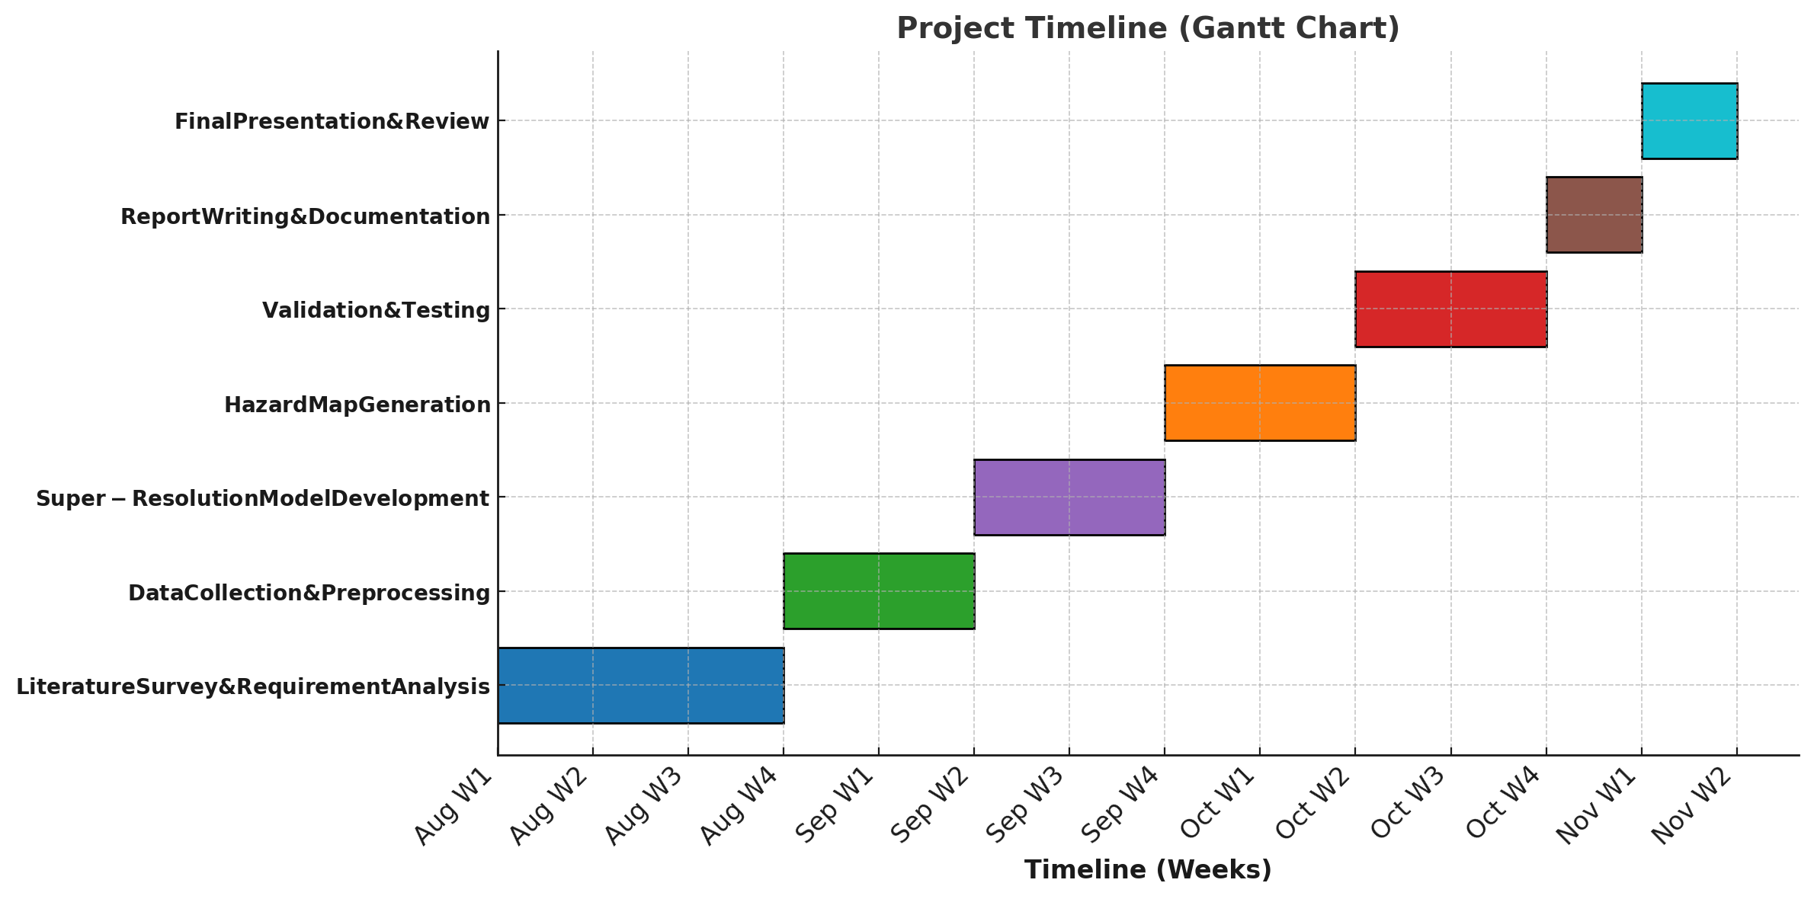
Timeline of the Project (Gantt Chart)

Slide 12
References (IEEE Paper format)
[1] McEwen, A. S., et al. (2007). Mars Reconnaissance Orbiter’s High Resolution Imaging Science Experiment (HiRISE). Journal of Geophysical Research: Planets, 112(E5).
[2] Mattson, S., et al. (2019). HiRISE Digital Terrain Models (DTMs) derived from stereo pairs. NASA PDS.
[3] Golombek, M. P., et al. (2012). Selection of the Mars Science Laboratory landing site. Space Science Reviews, 170(1-4), 641–737.
[4] Fergason, R. L., et al. (2020). Surface properties of the InSight landing site. Nature Geoscience, 13, 183–189.
[5] Mandt, K. E., et al. (2021). Hazard analysis for landing sites on Mars. Planetary and Space Science, 199, 105197.

Slide 13


